Slide 1

Predicting Employee Attrition
Presented by:
1.Geetanjani reddy
(Team Lead)
2.Tutta Subrahmanya swami
3.Niharika Ryali
4.Kundeti Siva Umashankar
5.Narala Prasanth
6.K Likhith Venkat vinay
7.Paul Ravi kiran vara
Under The Guidance Of
GAURAV SINGH
Senior Faculty Data Science

Slide 2

Business Objective, Understanding and Approach
Business Objective
Understanding
Business Objective
Understanding
An IT company has a workforce of around 4,000 employees. Every year around 15% of the employees leave the company and need to be replaced with new hires. The leadership believes that 15% attrition is bad for the company’s revenue and future growth. The Company has approached you to build a machine learning model it should guide the company to take timely action to retain as many employees as possible
Out of 4000 people In an IT company we have 15% Attrition rate.we have to find the reasons behind the attrition and the solutions to make them sustain in the IT company
Approach
The first step involves the cleaning of the given data which includes identifying missing values , checking duplicate rows and dropping unnecessary columns.
The next step is data preprocessing which involves exploratory data analysis and feature engineering
After collecting the data and analysing the patterns it exhibits, The predicted feature is of continous variable so a decision tree machine learning model has to be used to encounter this

Slide 3
Analysis/ Modeling Methodology
Data Preparation & EDA
Variable Creation and Selection
Model Development
Model Performance Testing
Plotted certain plots which are needed.
Corrected the missing values in the variables.
There are no outliers for all numeric variables.
Converted object variables into dummy values to proceed further except target variable.
Removed unwanted Features which are not meaningful.
Decision tree classifier is chosen as the preferred modeling technique since the predicted feature is continuous
Developed 2 candidate models
Highest Model accuracy observed of 92%
The Training accuracy observed to be 97%.
The Testing accuracy observed to be 92%.

Slide 4
Extended Data Dictionary (EDD)
Variable | Variable Type | Min | 1% | 5% | 25% | 50% | Mean | 75% | 95% | 99% | Max
Age | int64 | 18.00 | 19.00 | 24.00 | 30.00 | 36.00 | 36.92 | 43.00 | 54.00 | 58.00 | 60.00
Education | int64 | 1.00 | 1.00 | 1.00 | 2.00 | 3.00 | 2.91 | 4.00 | 4.00 | 5.00 | 5.00
Total working years | float64 | 0.00 | 1.00 | 1.00 | 6.00 | 10.00 | 11.27 | 15.00 | 25.00 | 38.00 | 40.00
Distance from home | int64 | 1.00 | 1.00 | 1.00 | 2.00 | 7.00 | 9.19 | 14.00 | 26.00 | 29.00 | 29.00
Years with current manager | int64 | 0.00 | 0.00 | 0.00 | 2.00 | 3.00 | 4.12 | 7.00 | 10.00 | 14.00 | 17.00
Stock option level | int64 | 0.00 | 0.00 | 0.00 | 0.00 | 1.00 | 0.79 | 1.00 | 3.00 | 3.00 | 3.00
Number of companies worked | float64 | 0.00 | 0.00 | 0.00 | 1.00 | 2.00 | 2.69 | 4.00 | 8.00 | 9.00 | 9.00

Slide 5
Feature Engineering – New variables created
S.no | Variable Name | Variable Type | Description
1 | Business Travel | Object | Dummy(1/0) based on criteria being met or not
2 | Department | Object | Dummy(1/0) based on criteria being met or not
3 | Education field | Object | Dummy(1/0) based on criteria being met or not
4 | Gender | Object | Dummy(1/0) based on criteria being met or not
5 | Marital Status | Object | Dummy(1/0) based on criteria being met or not
6 | Job Role | Object | Dummy(1/0) based on criteria being met or not
7 | Over18 | Object | Dummy(1/0) based on criteria being met or not

Slide 6
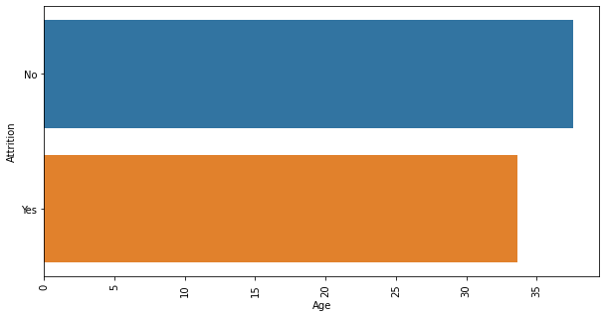
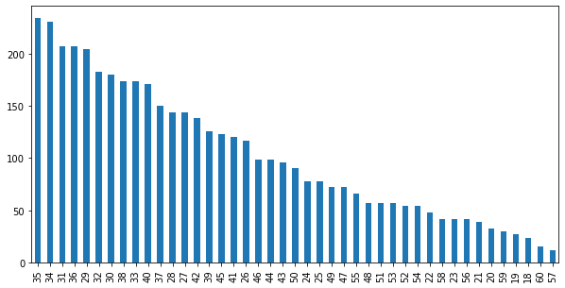
EXPLORATORY DATA ANALYSIS:
Age Column
Plotting Against Age and Attrition
Key Findings :
1.The people in the age group 35-40 are more in the company .
2.The people in the age group 57-60 are less in the company.
Key Findings :
1.The age group people above 35 are willing to stay in the company.
2.The age group people below 35 are saying yes to attrition.

Slide 7
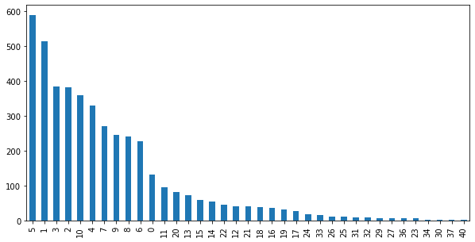
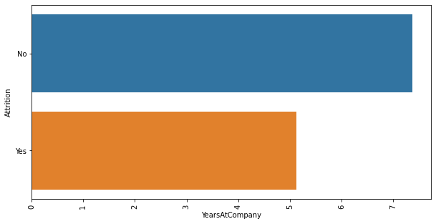
YearsAtCompany Column
YearsAtCompany Against Attrition
Key Findings :
The people who worked five years more in the company and there are no people in the company who had 37 to 40 work experience.
Key Findings :
The people who had work experience of 7 years are willing to stay in the company and the people of work experience 5 years are leaving the company.

Slide 8
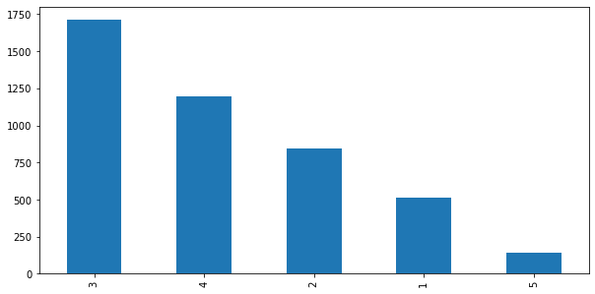
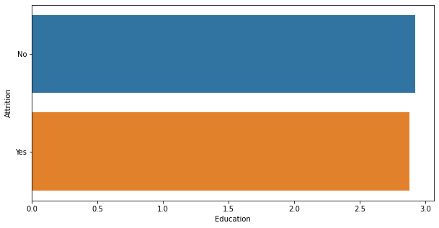
Education Column
Plotting Education against Attrition
Key Findings :
The people who are highly educated are more in the company and who had low level educated people are comparatively low in the company.
Key Findings :
The people who are highly educated are willing to stay In the company.
The people who are less educated are leaving the company compared to high level.

Slide 9
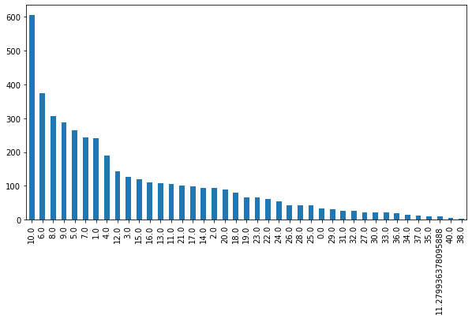
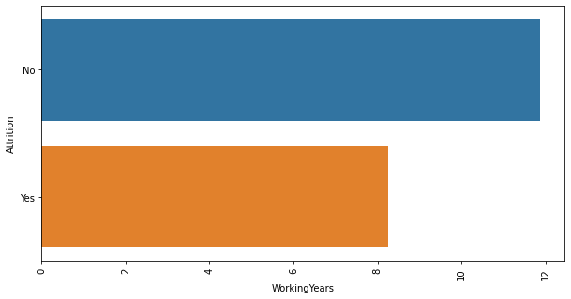
WorkingYears Column
Plotting WorkingYears against Attrition
Key Findings :
The people who are working since 10 years are more in the company and the people who worked more than 36 years are very low.
Key Findings :
The people who worked more than 10 years are willing to stay in the company than compared the people who worked less than 5 years.

Slide 10
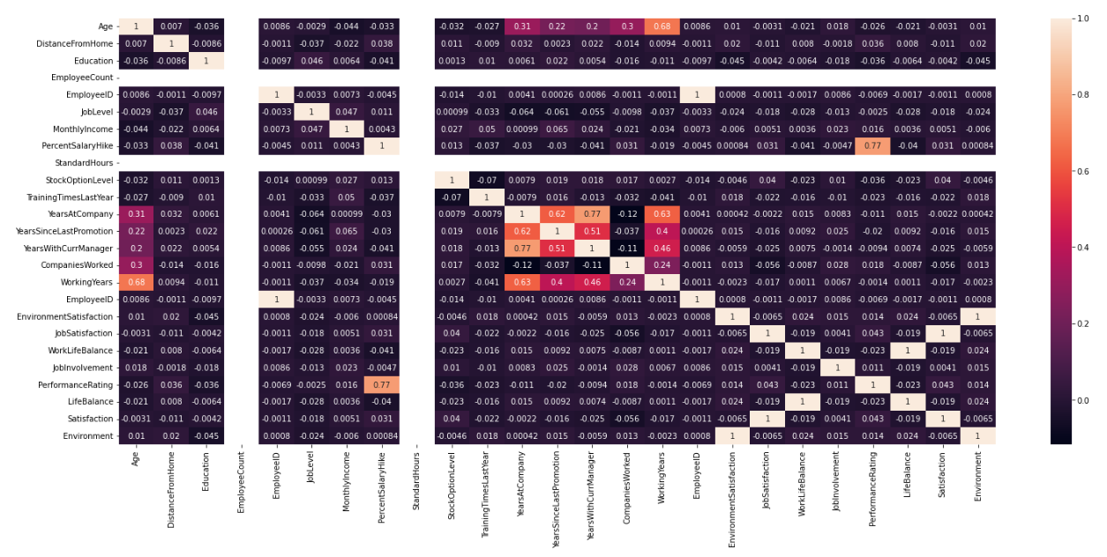
Correlation Matrix

Slide 11
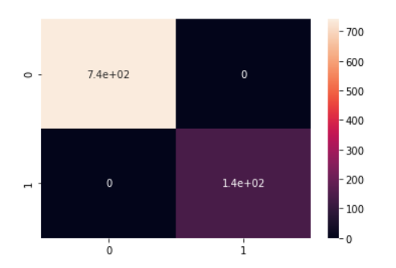
Confusion Matrix

Slide 12
Hyper Parameter Tuning
Parameters | Values
Criteria | gini
Max_Depth | 13
Min_Samples_leaf | 5
Splitter | Best
Key Findings :
From this dataset we obtained the best model with the accuracy 92% based on the parameters: Criteria, Max_Depth , Min_Sanples_leaf, Splitter.
This shows the Hyper Parameter Tuning of Parameters with the following values : gini, 13, 5, Best respectively.

Slide 13
FEATURE ENGINEERING
We converted object variables into respective dummy variables and their columns are
Business Travel - Non-Travel
Travel_Frequently
Travel_Rarely
Department - Research and development sales
Life sciences
Marketing
Medical
Other
Education field - Technical Degree
Gender - Male
job role - Human resources
Laboratory technician
Manager
Manufacturing director
Research director
Research director
Research scientist
Sales executive
Sales representative
Marital status - Married
Single

Slide 14
PERFORMANCE COMPARISOM BETWEEN TRAIN AND TEST DATA
After data pre-processing the dataset is divided into 80% and 20% split in which 80% of records of dataset are used as training dataset to build the model and 20% of records dataset is used as testing dataset to test the accuracy of prediction of the model.
Coming to the comparison of performance using training dataset and testing dataset, Training dataset has 97% as accuracy and Testing dataset has achieved 92% as accuracy.
The model performed well on both the training and testing datasets.
Cross validation
For the further validation, Cross Validation technique is used with k-Fold values 5,10 and 15.
The average score that is obtained is turned out to be around 0.80.

Slide 15
Kind of feature engineering applied:
The type of Feature engineering applied is the extraction of Main information and clubbing them into less number of classes from the features having higher cardinality without loosing out on vital information.
Dummy variables technique is applied on the Categorical features.
Technical requirements that the client needs to meet:
The client should have a data sheets in Excel, Should use libraries like NumPy, Pandas, Visualization tools for the better understanding of the distribution of the data.•

Slide 16
The type of data cleaning that the client needs to make is
1) The missing values are needed to be taken care of
2) There shouldn’t be any duplicated records
3) If there are any outliers found they need to be taken care of
4) Fix structural errors
5) Drop irrelevant features
DATA PRE-PROCESSING
The type of data Pre-processing that the client needs to make is
1)Feature extraction and select
2)Transform the data into meaningful variables
3)Feature scaling
4)Encode the categorical variables (dummy variables, one hot encoding)
5)Splitting the dataset into training and testing
DATA CLEANING

Slide 17
MODEL VALIDATION
Model accuracy = 92%
Precision = 0.75-Yes, 0.77-No.
Recall = 141
Cross Validation = 0.81, 0.80, 0.79
F1_Score = 0.94

Slide 18


